Slide 1
GEOSS
Architecture Implementation Pilot, Phase 3
- AIP-3 Initial Concepts -
George Percivall,
Open Geospatial Consortium
GEO Task AR-09-01b Task POC
September 2009

Slide 2
GEO Task AR-09-01b
Architecture Implementation Pilot
Develop and pilot new process and infrastructure components for the GCI and the broader GEOSS architecture
Through continuation of existing efforts and new activities solicited through AIP Calls for Participation and other means;
  Including continuation of IP3
Slide <number>
Notes:
Consistent with that, Task AR 09-01b is defined as: highlighting the development and testing of contributed components in a pilot setting, the leveraging of the GEOSS Common Infrastructure portals and clearinghouses, doing that via interoperability arrangements and serving the SBAs.

Slide 3
GEOSS AIP-3 Potential Topics
Build on: GEOSS Common Infrastructure; and the AIP-2 architecture, deployed components and development process
SBAs to be identified working with the UIC. Potential communities of practice include:
  AIP-2 SBAs to be considered
  New SBAs: Environmental Monitoring, Oceans and coastal zones, Hydrology and drought management; Humanitarian response to disaster
Focus on data: global datasets; data quality; licenses and user management; information architecture
  Include feature model and feature types.
  Observables for EO, including discussion of registries and ontologies.
  Coordination with the User Requirements Registry regarding observables and other topics relevant to AIP-3.
© 2009 Open Geospatial Consortium, Inc.

Slide 4
Concept for Environmental Monitoring in AIP-3
EEA and EPA are seeking to coordinate on a service architecture for environmental monitoring with data exchange between their agencies and their member states, and among the member states themselves:
  EPA Exchange Network
  European environment information and observation network (Eionet) for this and other EEA networks.
AIP-3 provides a proven forum and process for EEA and EPA to work collaboratively with the GEO community
  Industry involvement would be a specific objective through OGC
EEA and EPA would be source for an environmental quality reporting framework scenario to be in the AIP-3 CFP: web-based modeling & analysis linked to data feeds and repositories.
AIP provides the structured framework for implementing the scenario in a service architecture based on Interoperability Arrangements,
  e.g., OGC SWE, WPS, GML, WaterML
© 2009 Open Geospatial Consortium, Inc.

Slide 5

AIP Development Approach
Participation
AR-09-01b Architecture Implementation Pilot
Evolutionary Development Process
Concept
Development
Participation
Continuous interaction with external activities
Call for
Participation
Participation
Kick-off
Workshop
Updates for each step
Participation
Architecture
Documentation
Development
Activities
Participation
Baseline
Persistent
Operations
(AR-09-01a)
Operational Baseline and Lessons Learned for next evolutionary spiral
Notes:
The pilot development approach is a evolutionary spiral waterfall approach that relies heavily on community participation and feeds into task AR-09-01a and the next evolutionary spiral.

Slide 6
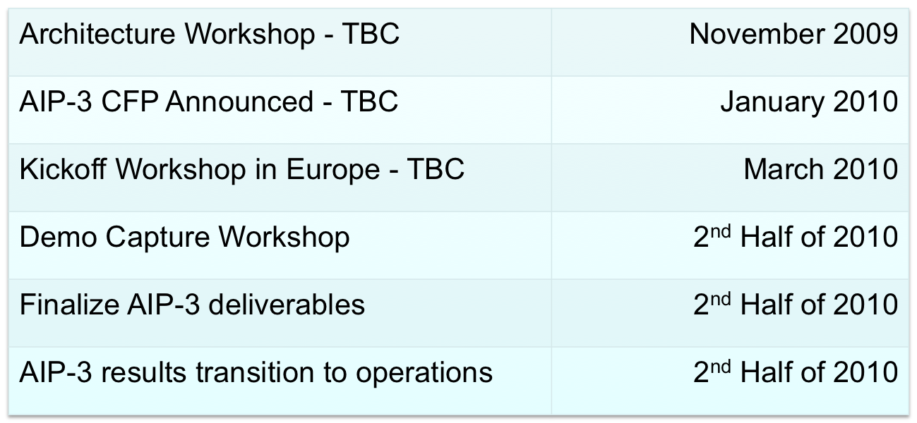
AIP-3 Master Schedule – Draft
– All dates are preliminary estimates

